Slide 1
Titanic Data
Project 5

Slide 2
Overview
Objective
Data Set
Cleaning/Set Up Data
Model
Logistic Regression
GridSearch Logistic Regression
KNN
KNN with Grid Search
Important Takeaway

Slide 3
Objective
Create models to determine the likelihood of passenger survival on the Titanic

Slide 4
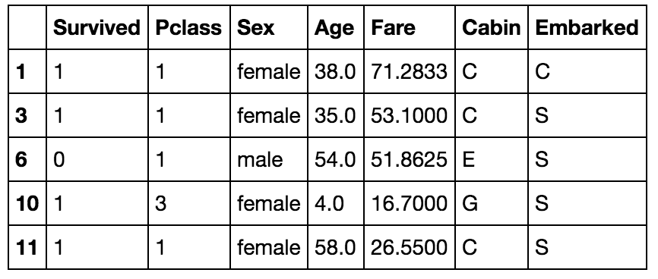
Data Set
Titanic Data Set from Kaggle
Features: Pclass, Sex, Age, Fare, Cabin, Embarked
202 rows of non-null

Slide 5
Cleaning/Set Up Data
Dummy Variables
Features: Pclass, Sex, Cabin, Embarked
Scaled Variables
Features: Age, Fare, Pclass, Sex, Cabin, Embarked
Prediction: Survived

Slide 6
Models
2 Models used Logistic Regression, KNN
Variables Used for Prediction
Features:
Model
Train Model
Age, Fare, Pclass, Sex, Cabin, Embarked
GridSearchCV
Logistic Regression
Test Train Split
Best Param Logistic Regression
Features:
Model
Train Model
Age, Fare, Pclass, Sex, Cabin, Embarked
GridSearchCV
KNN
Test Train Split
Best Param KNN

Slide 7
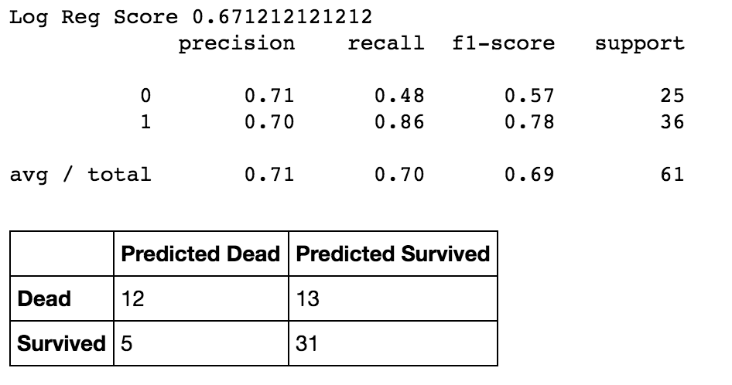
Logistic Regression
LogisticRegression(self, penalty='l2', dual=False, tol=0.0001, C=1.0, fit_intercept=True, intercept_scaling=1, class_weight=None, random_state=None, solver='liblinear', max_iter=100, multi_class='ovr', verbose=0, warm_start=False, n_jobs=1)

Slide 8
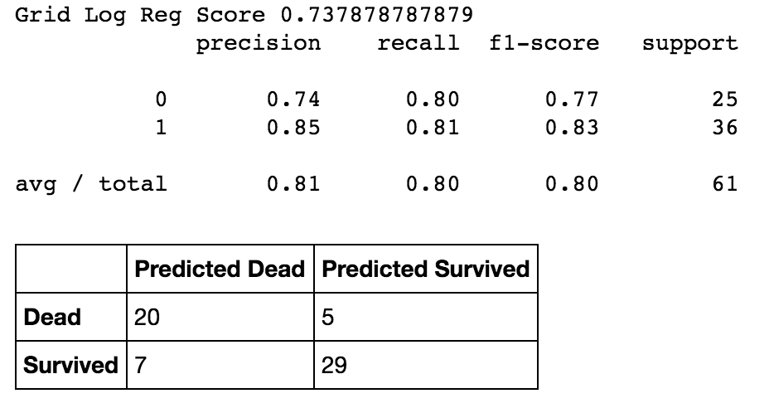
GridSearch Logistic Regression
logreg_parameters = {
'penalty':['l1','l2'],
'C':np.logspace(-5,1,50),
'solver':['liblinear']
}
BEST params {'penalty': 'l1', 'C': 0.19306977288832497, 'solver': 'liblinear'}

Slide 9
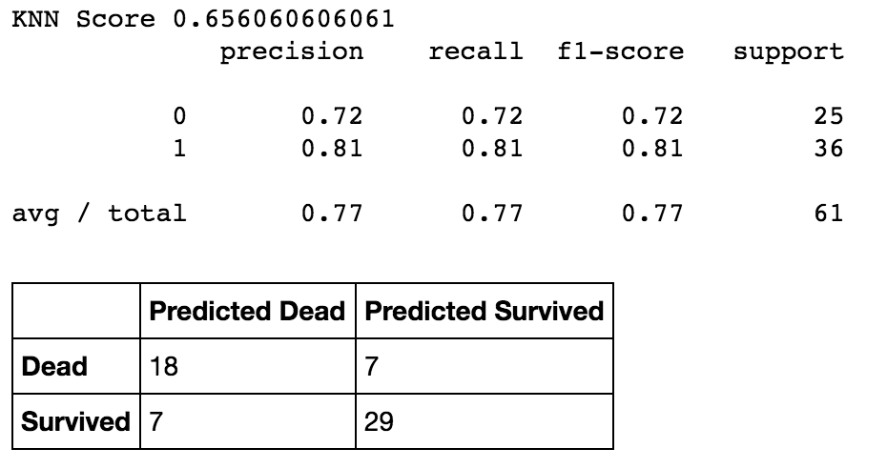
KNN
KNeighborsClassifier(self, n_neighbors=5, weights='uniform', algorithm='auto', leaf_size=30, p=2, metric='minkowski', metric_params=None, n_jobs=1, **kwargs)

Slide 10
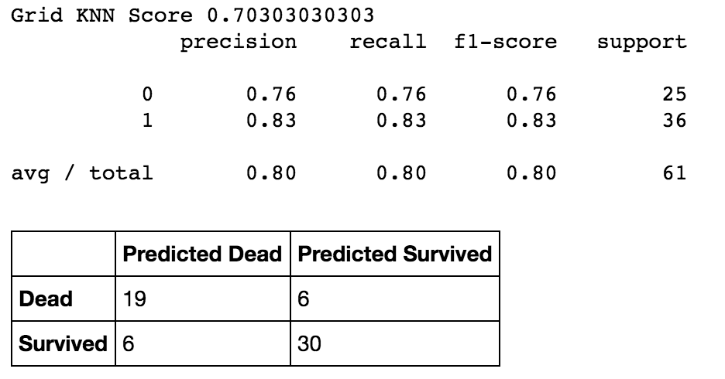
GridSearchKNN
params = {'n_neighbors': range(2,50)}
BEST params {'n_neighbors': 3}

Slide 11

Important Takeaway

